Slide 1
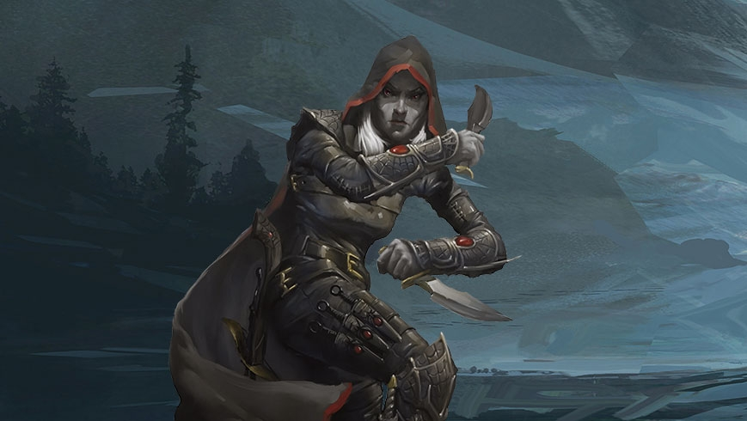
Shinobi Assassin
A 2D Platformer with a stealth twist
By DJ Cmar
CIST 2742 Intro to Python

Slide 2
Movement
Shinobi Assassin is a platformer. This means the player can go left and right and will be affected by gravity vertically. This is offset by giving the player the ability to jump.
The enemies in the game also use the same movement mechanics to travel.

Slide 3
Camera
Shinobi Assassin utilizes a camera in it in order to follow the player around while trying to explore the area.
This works by pushing every sprite by a given offset based on how far a player is to the right/left and how far up/down they are.
The camera adds a sense of mystery to the player because they do not know what to expect next.

Slide 4
Goal
The goal for the player is to find the end of the level so that he may make his escape. This is done by traveling throughout the level, but also dispatching enemies that are on the way.
Since the stealth component of the game is so important, the player does not get many chances to take damage before he dies.

Slide 5
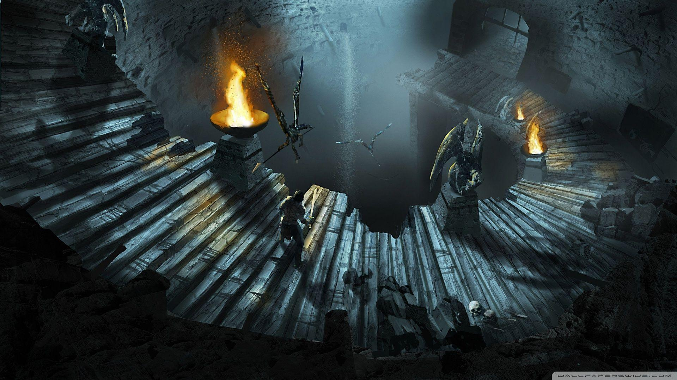
Enemies
Enemies’ AI are dictated by 3 statuses
Normal – the enemies have the shortest line of sight and expect nothing to happen. They go on about their business and stick to their post or patrol
Caution – the enemies have the longest line of sight and are going to approach your last known location
Alert – the enemies have seen you and will now chase you down until they are defeated or evaded

Slide 6
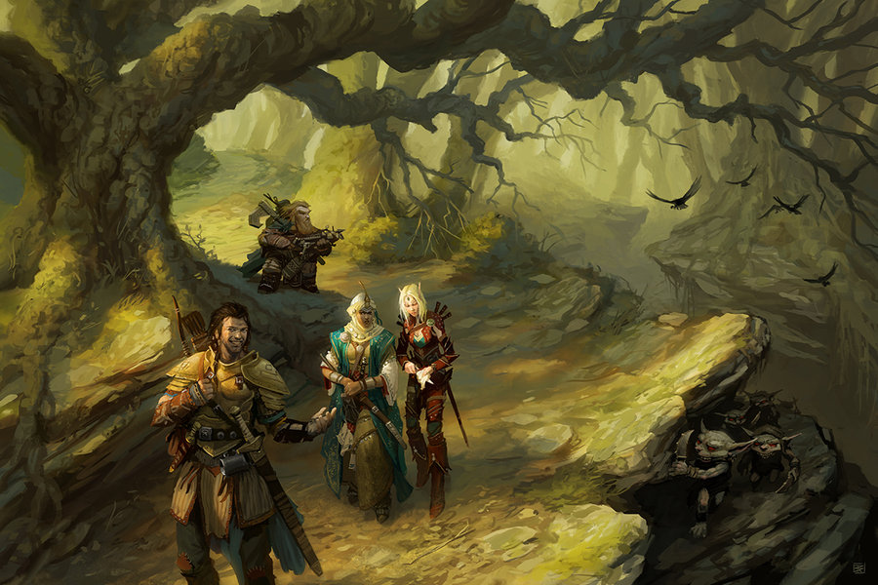
Pathfinding AI
The enemies come equipped with a simple pathfinding AI and will traverse based on how many solid blocks are surrounding them and where they want to go. Here are some examples:
Target is below – The AI will try to find a gap in the platform below them to get to the location
Target is above – The AI will try to locate a jumpable platform and then jump if there is enough space, otherwise they will back up and then jump
Target is across – The AI will approach the target and then jump across any gaps they come across

Slide 7
Broadcast Player Location
If the player is found by an enemy and there is another enemy nearby, the other enemy will now cautiously approach the location where the player was last spotted.
The player can still manage to get away from the situation and avoid conflict
This goes to show the old saying “there are power in numbers”

Slide 8
Attacking and Jumping
A player and enemy can only attack and jump so often, this to add an old school feel to the game. In many older games, the player can only jump on the ground and will automatically propel them in a certain direction. This is true for Shinobi Assassin as well.
If an enemy or a player is hit with an attack, they are pushed in the direction from where they were attacked from.
The enemy knows when they are in attacking range, It is best to try to stab them in the back so they don’t get the chance in the first place.

Slide 9
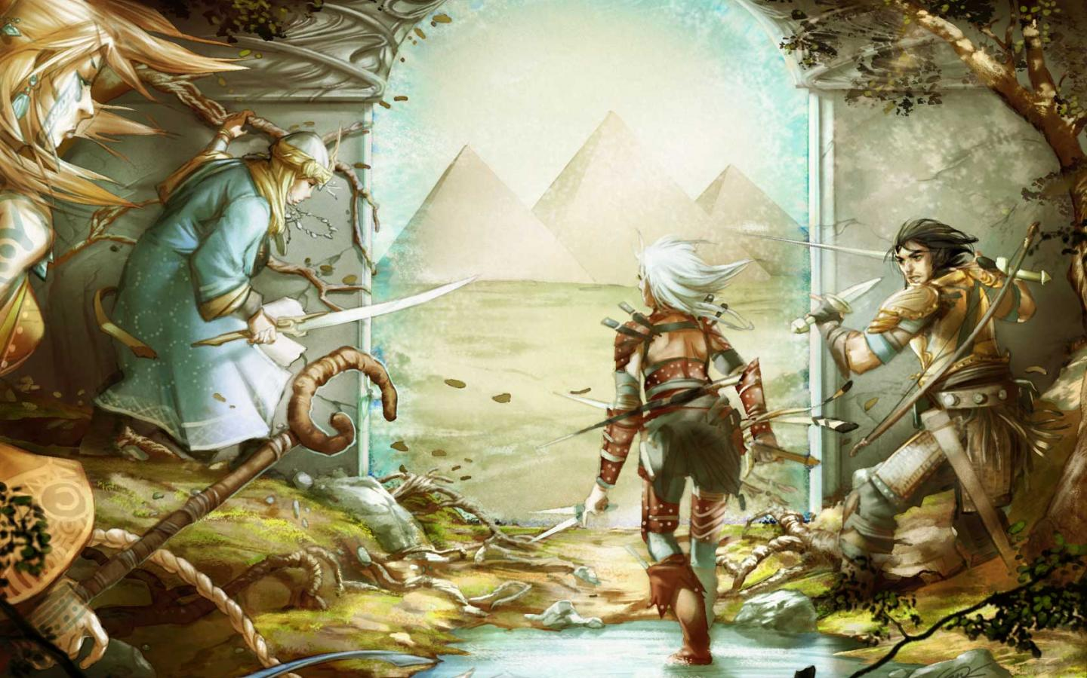
Game Over and Victory
Victory is achieved when the player manages to get to the end of the level. This is achieved by walking through the doorway (which is the path that is furthest to the right of the map)
Game Over is fulfilled when a player looses all hearts. The enemies tend to parade around the player like a bunch of jerks or stand there judging you (yes, this is intended)

Slide 10

-To Summarize-
Shinobi Assassin features these mechanics which make it unique to itself.
Movement – 2D platforming with arcade style mechanics
Camera – moves the world and gives the player a sense of freedom
Enemies – A Pathfinding AI thats designed to hunt down the player in small groups
Old School Style and Mechanics – Gives the game a retro look and feel. This is fully intended, as it is supposed to appeal to those who played in the golden age of gaming.

